Slide 1
Bond/Debt Valuation

Slide 2
Quick summary of sources of financing
A firm’s “liabilities” consists of investors who get paid from the firm’s free cash flows
A firm’s “value” V is the total market value of all the liabilities that have a claim on those cash flows:
$$V_{Firm}=V_{Debt}+V_{Preferred}+V_{Equity}+…$$
 | Debt | Preferred | Equity
Payment | Fixed promised payment | Fixed payment (e.g. 8% dividend), but payment optional | Residual (whatever is left over)
Priority in bankruptcy | Highest | Middle | Lowest
Risk/beta | Low | Middle | High
Expected return | Low | Middle | High
Voting/control rights | No (as long as paid as promised) | No (but sometimes convertible to equity) | Yes
Term | Dated | Perpetual | Perpetual
Total financing (of U.S. aggregate corporate market values) | ~25% | ~1% (and mainly by financial firms) | ~75%

Slide 3
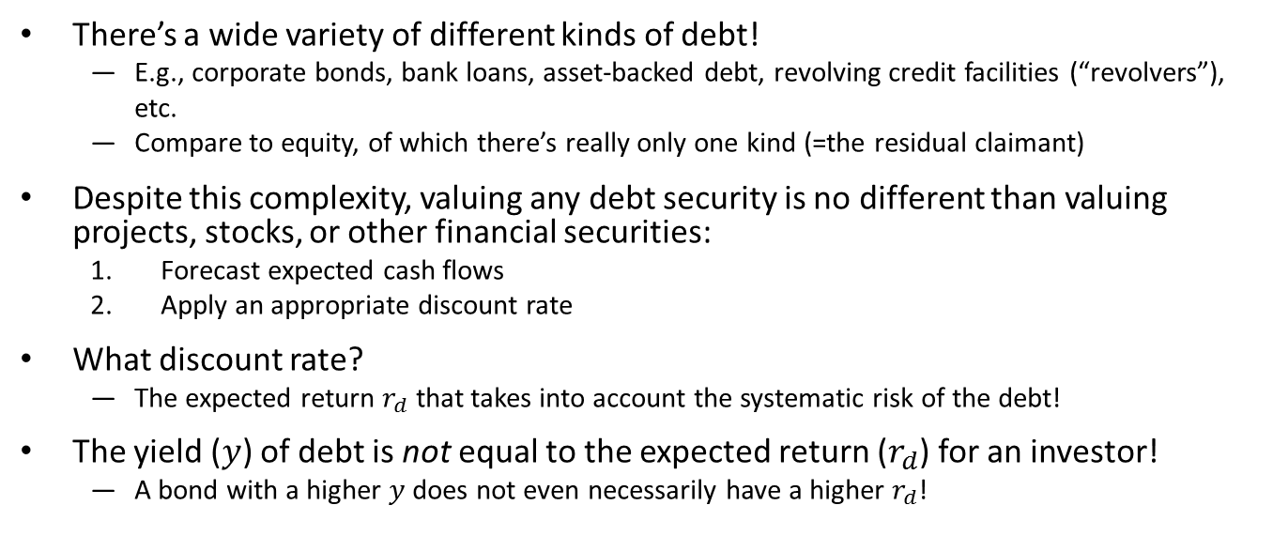
How to value debt
There’s a wide variety of different kinds of debt!
E.g., corporate bonds, bank loans, asset-backed debt, revolving credit facilities (“revolvers”), etc.
Compare to equity, of which there’s really only one kind (=the residual claimant)
Despite this complexity, valuing any debt security is no different than valuing projects, stocks, or other financial securities:
Forecast expected cash flows
Apply an appropriate discount rate
What discount rate?
The expected return $r_{d}$ that takes into account the systematic risk of the debt!
The yield ($y$) of debt is not equal to the expected return ($r_{d}$) for an investor!
A bond with a higher $y$ does not even necessarily have a higher $r_{d}$!

Slide 4
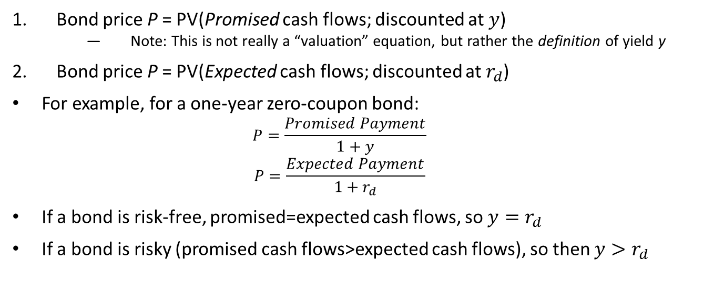
Two important formulas
Bond price P = PV(Promised cash flows; discounted at $y$)
Note: This is not really a “valuation” equation, but rather the definition of yield y
Bond price P = PV(Expected cash flows; discounted at $r_{d}$)
For example, for a one-year zero-coupon bond:
$$P=\frac{Promised Payment}{1+y}$$
$$P=\frac{Expected Payment}{1+r_{d}}$$
If a bond is risk-free, promised=expected cash flows, so $y=r_{d}$
If a bond is risky (promised cash flows>expected cash flows), so then $y>r_{d}$

Slide 5
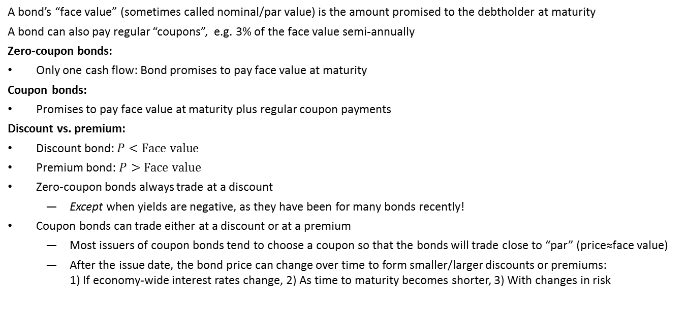
Coupons, discounts, and premiums
A bond’s “face value” (sometimes called nominal/par value) is the amount promised to the debtholder at maturity
A bond can also pay regular “coupons”, e.g. 3% of the face value semi-annually
Zero-coupon bonds:
Only one cash flow: Bond promises to pay face value at maturity
Coupon bonds:
Promises to pay face value at maturity plus regular coupon payments
Discount vs. premium:
Discount bond: $P<Face value$
Premium bond: $P>Face value$
Zero-coupon bonds always trade at a discount
Except when yields are negative, as they have been for many bonds recently!
Coupon bonds can trade either at a discount or at a premium
Most issuers of coupon bonds tend to choose a coupon so that the bonds will trade close to “par” (price≈face value)
After the issue date, the bond price can change over time to form smaller/larger discounts or premiums: 1) If economy-wide interest rates change, 2) As time to maturity becomes shorter, 3) With changes in risk
Notes:
5

Slide 6
Example: Relating Yield and Prices
Consider a ten-year, $1000 bond with 1.1% annual coupons
Suppose the bond’s yield y is 1%
What price is the bond trading for?
Face value
Annual coupon
Notes:
6

Slide 7
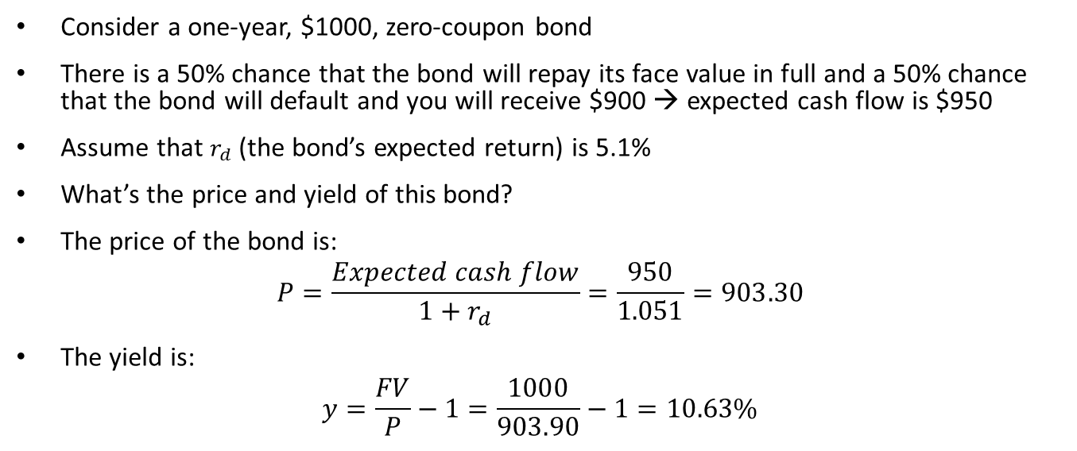
Example: Valuing a risky bond
Consider a one-year, $1000, zero-coupon bond
There is a 50% chance that the bond will repay its face value in full and a 50% chance that the bond will default and you will receive $900 → expected cash flow is $950
Assume that $r_{d}$ (the bond’s expected return) is 5.1%
What’s the price and yield of this bond?
The price of the bond is:
$$P=\frac{Expected cash flow}{1+r_{d}}=\frac{950}{1.051}=903.30$$
The yield is:
$$y=\frac{FV}{P}−1=\frac{1000}{903.90}−1=10.63\%$$

Slide 8
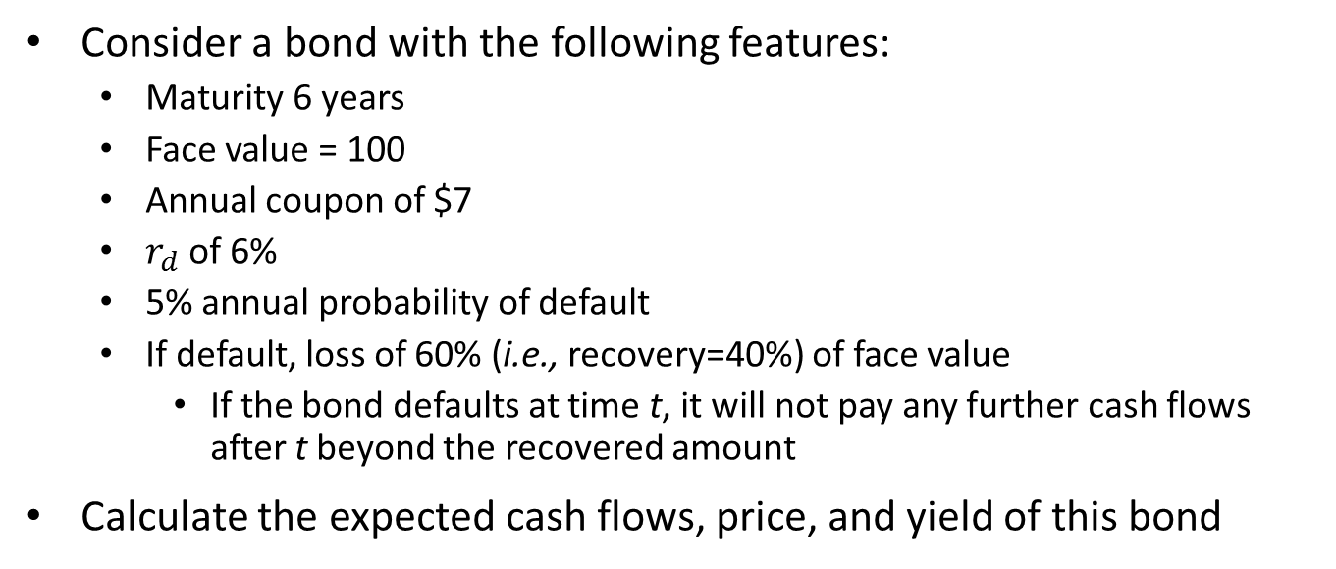
Example: Valuing a longer-term coupon bond
Consider a bond with the following features:
Maturity 6 years
Face value = 100
Annual coupon of $7
$r_{d}$ of 6%
5% annual probability of default
If default, loss of 60% (i.e., recovery=40%) of face value
If the bond defaults at time t, it will not pay any further cash flows after t beyond the recovered amount
Calculate the expected cash flows, price, and yield of this bond

Slide 9
A longer example – Cash flows and Price
Assumptions:
face value | $100
coupon | $7
r_d (discount rate) | 6%
annual prob of default | 5%
recovery % | 40%
Year | p (default) | cum. prob of survival
1 | 0.0500 | 0.9500
2 | 0.0475 | 0.9025
3 | 0.0451 | 0.8574
4 | 0.0429 | 0.8145
5 | 0.0407 | 0.7738
6 | 0.0387 | 0.7351
cash flows (if default) | cash flows (if survive)
$40 | $7
$40 | $7
$40 | $7
$40 | $7
$40 | $7
$40 | $107
E[CF] | PV
8.65 | 8.16
8.22 | 7.31
7.81 | 6.55
7.42 | 5.87
7.05 | 5.26
80.20 | 56.54
Price: $89.71

Slide 10
A longer example – Yield
Recall, yield is the “discount rate” that sets price equal to the PV of promised payments (i.e., an “IRR”):
Year | Cash flows
0 | -89.71
1 | 7
2 | 7
3 | 7
4 | 7
5 | 7
6 | 107
y | 9.32%

Slide 11
Seniority
Seniority describes the lender’s priority in claiming assets in default
“Secured” debt is collateralized with specific assets, has the highest priority
“Senior” debt has higher priority than…
“Junior” or “Subordinated” debt has lower priority
Lower seniority → Higher yield

Slide 12
Bond Covenants
Covenants are restrictive clauses in a bond contract
Limit the borrower from taking actions that may undercut its ability to repay the bonds
For example, covenants may:
Restrict the ability to pay dividends or sell assets
Restrict further new debt
Specify minimum capital and liquidity ratios
With more covenants, a borrower can reduce its costs of borrowing
Reduction in borrowing cost can outweigh the loss of flexibility associated with covenants
Especially important if borrowing firm may be in a position to take value-destroying actions, e.g. due to shareholder vs. debtholder conflicts of interest
We will talk more about these when we discuss optimal capital structure
Notes:
12

Slide 13
Private vs. Public Debt
Public debt
Bonds sold to the general public
A “Prospectus” or “Offering Memorandum” that is filed with the SEC describes a public debt offering
Private debt
Bank loans
Some common types of bank loans are:
Term Loan
Revolving Line of Credit
Often syndicated
Often collateralized/secured
Private placements
Bonds sold to a small group of investors instead of the general public
Lower SEC filing requirements than public bonds

Slide 14
Which is better: Private or Public?
Pros of Public Debt:
Larger investor base
Liquidity
Pros of Private Debt:
No registration with SEC
Avoid costs of filings
No need to reveal potentially confidential information
Easier to renegotiate
Dealing with fewer investors
Notes:
8

Slide 15
Bond Ratings
Rating agencies like S&P, Moody’s, and Fitch publish bond ratings that are intended to assess the credit-worthiness of a bond
S&P and Moody’s rate around 85% of all (publicly traded) bonds in the US, Fitch around 40%
There are also a few other rating agencies, but they are much smaller
The ratings depend on:
Probability of default
Expected loss in default (100%-”recovery”)
Recovery will depend both on firm characteristics, and the bond’s priority relative to the firm’s other bonds
Ratings can be useful to investors, but investors also should do their own due diligence!
A hard-learned lesson from the financial crisis for many investors…
Notes:
15

Slide 16
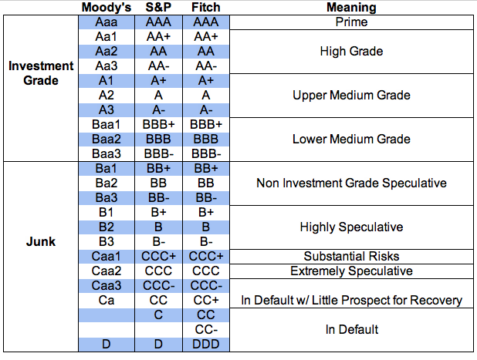
Rating scale
Ratings range from C- (lowest quality) to AAA (highest quality)
Investment-grade bonds (BBB- and higher)
Speculative bonds (BB+ and lower); also called “Junk” or “High yield”
Note: The cutoff between junk and investment grade is quite arbitrary
Very few firms nowadays have the highest bond ratings (AAA)
Many investors see “too high” ratings as wasteful (=a sign of “too little” debt)

Slide 17
The problem(s) with bond ratings?
Ratings are often used in financial regulation, which makes them very important to both firms and bond-investors
Investors like insurance companies, broker-dealers, banks, etc. need to hold more capital the lower-rated bonds they own
Gives firms a strong incentive to “manage” their ratings upwards
Ratings have been oft-criticized for many things:
Being overly generous (leading up to the financial crisis)
Being overly harsh (e.g., many governments complaining about downgrades)
Agencies are paid by the issuers – Potential conflict of interest?
Corporations and other bond issuers can choose which agencies to ask to rate them – Potential selection bias?

Slide 18
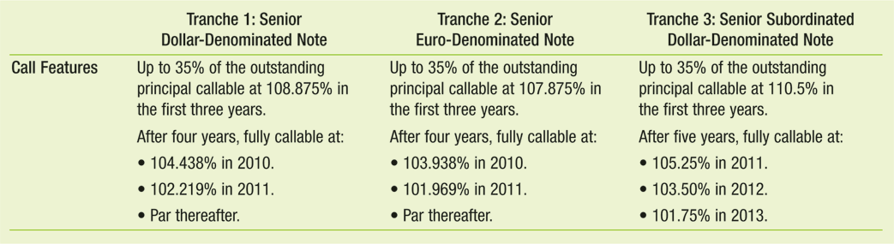
Callable bonds
Callable bonds can be repaid by the borrower before maturity
Important Call Features (“Provisions”):
Call Date; when the bond can be called (and how much of it)
Call Price/Premium; price at which the bond can be called
Example of call features (from Hertz buyout deal in 2005)
Notes:
18

Slide 19
The Price of Callable Bonds
A borrower is likely to call a bond if the call price is lower than the market price of a bond
E.g., if call price is the par value and the bond is trading at a premium
Usually happens if interest rates have declined
Therefore, because lenders can only lose from a call, the lenders will pay less (require a higher yield) for a callable bond than for an otherwise identical non-callable bond

Slide 20
Convertible bonds
Convertible bonds gives the lender an option to convert each bond into a fixed number of common stock
Conversion Ratio: The number of shares each bond (usually per $1000 of face value) can be converted to
Conversion Price: Implied stock price when converted
Consider a convertible bond with a $1000 face value and a conversion ratio of 20
If you converted the bond into stock on its maturity date, you would receive 20 shares
If you did not convert, you would receive $1000
By converting the bond you “give up” $1000 for 20 shares, implying a “conversion price” per share of $1,000/20 = $50
Convertible bonds are worth more to a lender than an otherwise identical non-convertible bond → Borrowers may be able to pay lower yields by issuing convertible bonds
Notes:
20

Slide 21
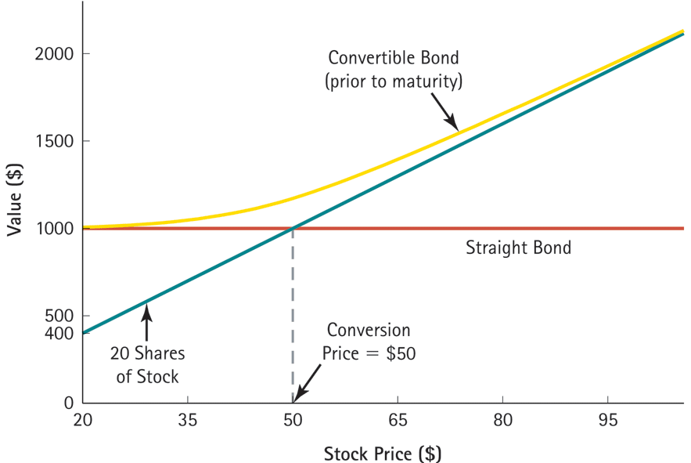
Convertible Bond Value
When a firm’s stock price is higher than the conversion price, convertible bond’s price is close to the value of the converted shares
When a firm’s stock price is low, the value is close to the value of a non-convertible (“straight”) bond

Slide 22
Short-term debt financing (Ch. 27.3-27.5)
Firms often rely on short-term debt financing to deal with immediate but short-lived cash needs
Private debt: Bank loans
Lines of credit
Public debt: Commercial paper
Huge market!
Tends to be bought by money-market funds
Unsecured
Secured short-term debt
E.g., backed by accounts receivables or inventory
Can be private or public

Slide 23
Valuation of public pensions (1)
Most public pension plans are “defined benefit”
Promise retirees a stream of fixed payments in the future → These promises can be valued using bond valuation methods!
Question: What discount rate r should we use to discount states’ and municipalities’ pension promises to calculate their present value?
Answer: A discount rate that corresponds with the riskiness of the pension promises!
How risky are these pensions?
Retirees and future retirees expect them to be hard promises
Should be discounted at rate close to risk-free! (or at most, using the municipal debt yield)
What discount rate do states and municipalities use in practice?
Hint: what discount rate makes their debt to future retirees look smaller?

Slide 24
Valuation of public pensions (2) What if we use a discount rate that’s too high?
In practice, state and local plans discount the pension promises based on the expected return of the assets held by the pension trust
Usually around 7.5-8%!
Using a discount rate based on the expected return of assets:
Reduces value of pension obligations as reported to the public
Encourages pension plans to invest in riskier portfolios to justify an even higher discount rate
As a plan takes on more risk, the more “soundly financed” the plan looks!
“Kicks the can forward”—some other politician will need to deal with the shortfall later

Slide 25
Example – Illinois DB funds (as of 2008—things haven’t gotten any better since…)
Total Assets of Four DB funds: $65.7bn
Stated Liabilities: $151.1bn
Liability at Treasury Rate: $284.8bn
Shortfall (using Treasury rate) is approximately 35% of GSP, approximately 8 times total State Revenues (around $35 billion)

